Slide 1
Support Vector Machine (SVM) Non Linear

Slide 2
If data is linearly arranged, then we can separate it by using a straight line, but for non-linear data, we cannot draw a single straight line.

Slide 3
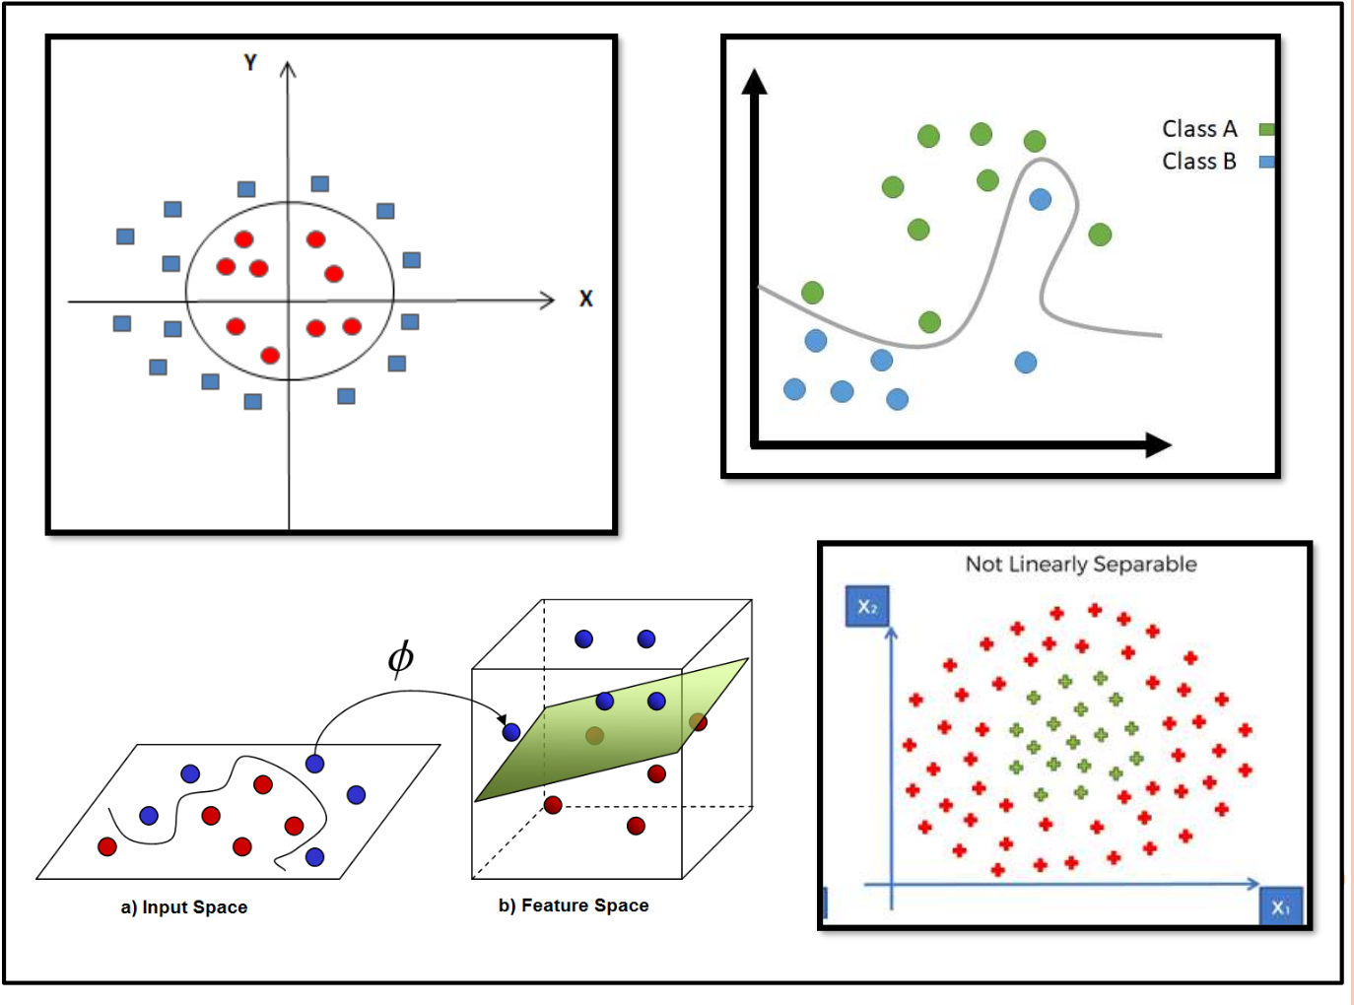

Slide 4
So ,here we use a kernel function to handle non-linear separable data.
Kernels are used by classification algorithms to solve non-linear classification problems.
The kernel function transforms the data into a higher dimensional feature space to make it possible to perform the linear separation.

Slide 5
The kernel function is a function that may be expressedas the dot product of the mapping function (kernel method) and looks like this, K(xi,xj) = Ø(xi) . Ø(xj)

Slide 6
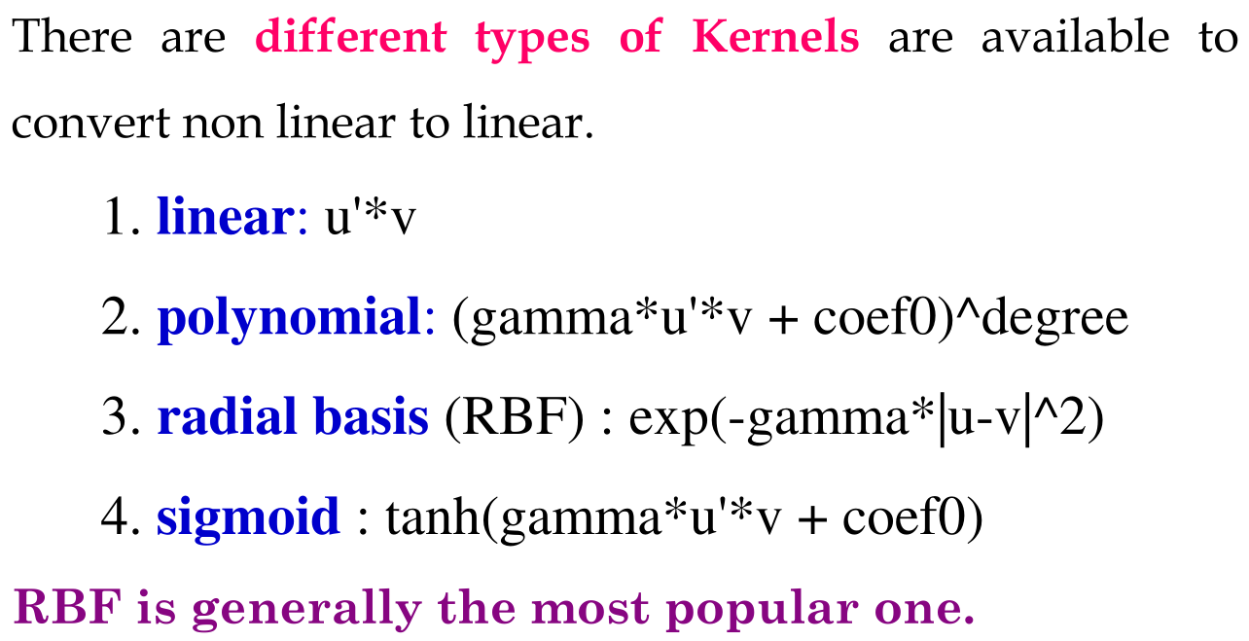

Slide 7
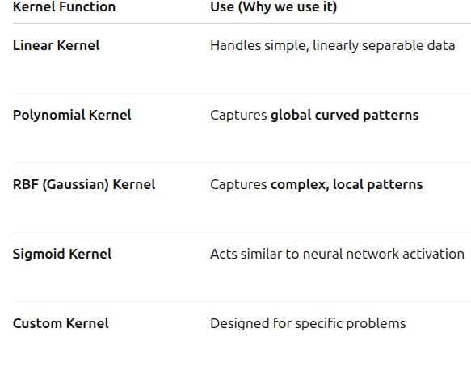

Slide 8
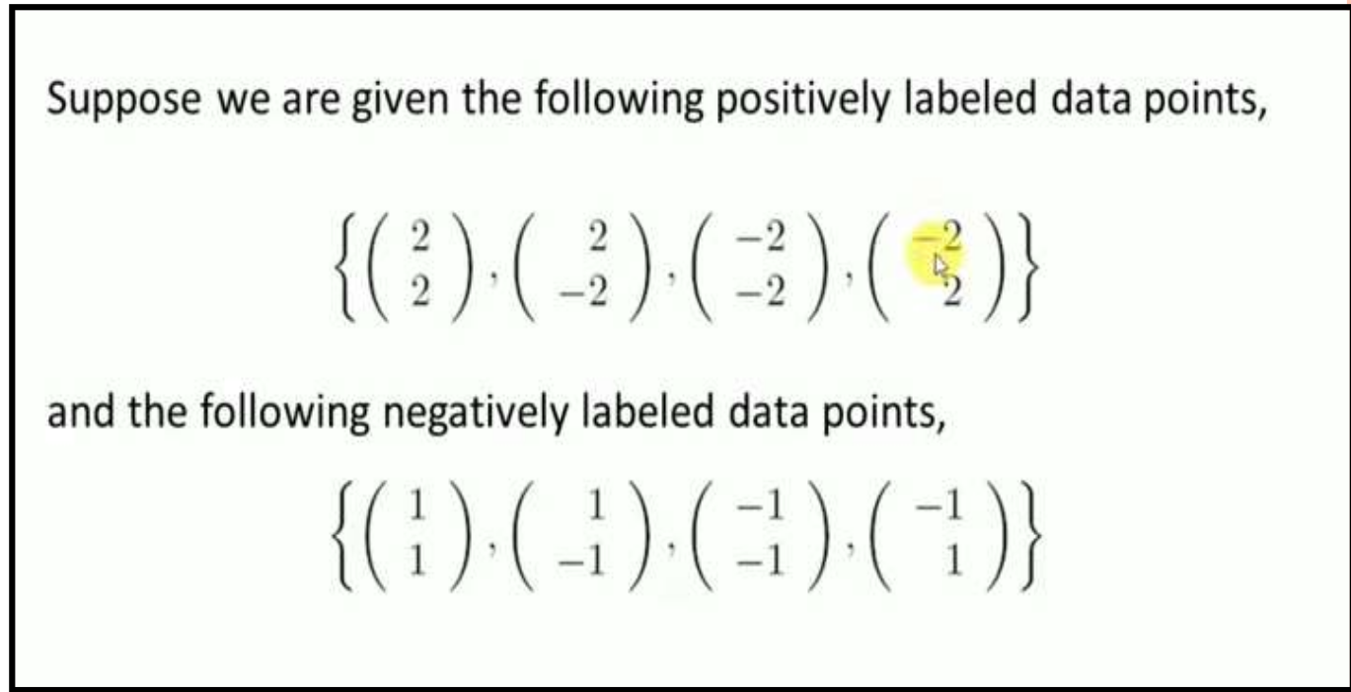
Example

Slide 9
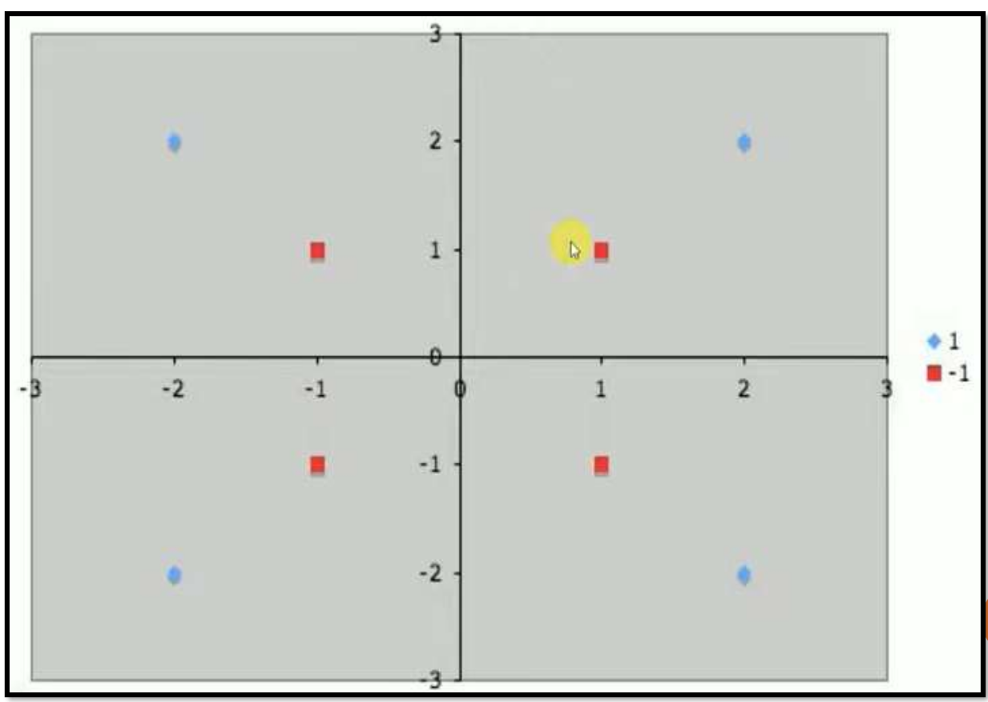


Slide 10
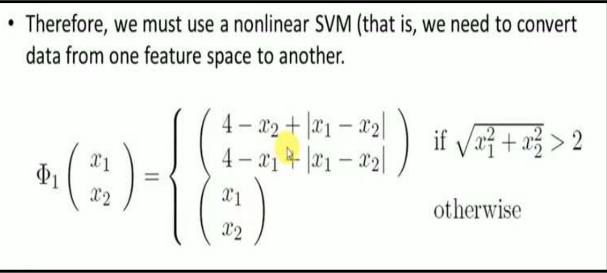

Slide 11
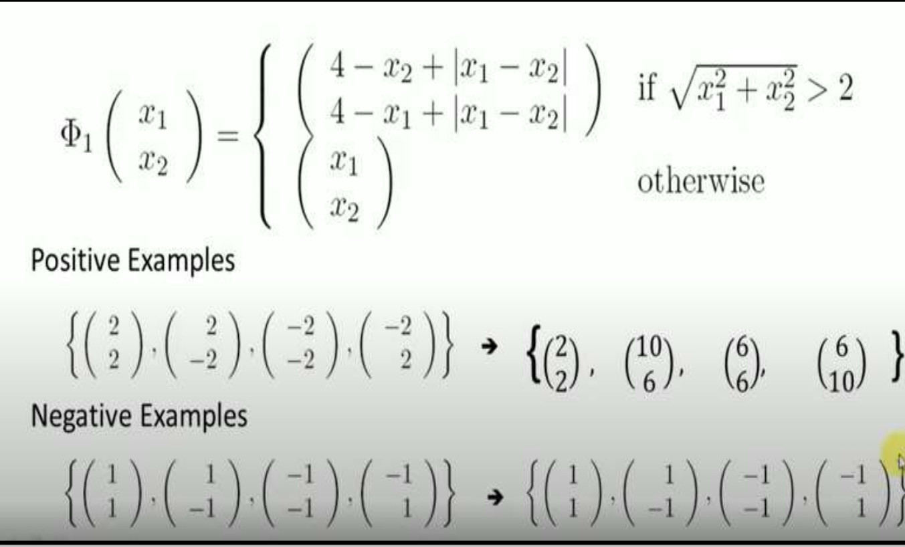

Slide 12
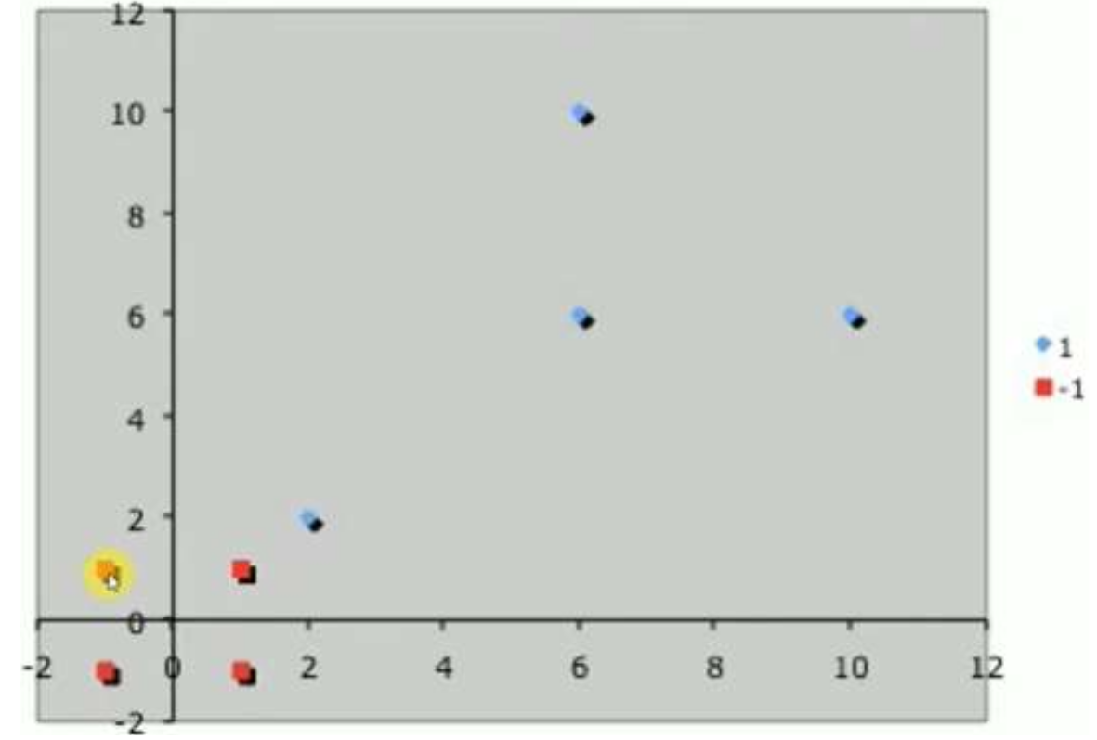
Updated data points

Slide 13
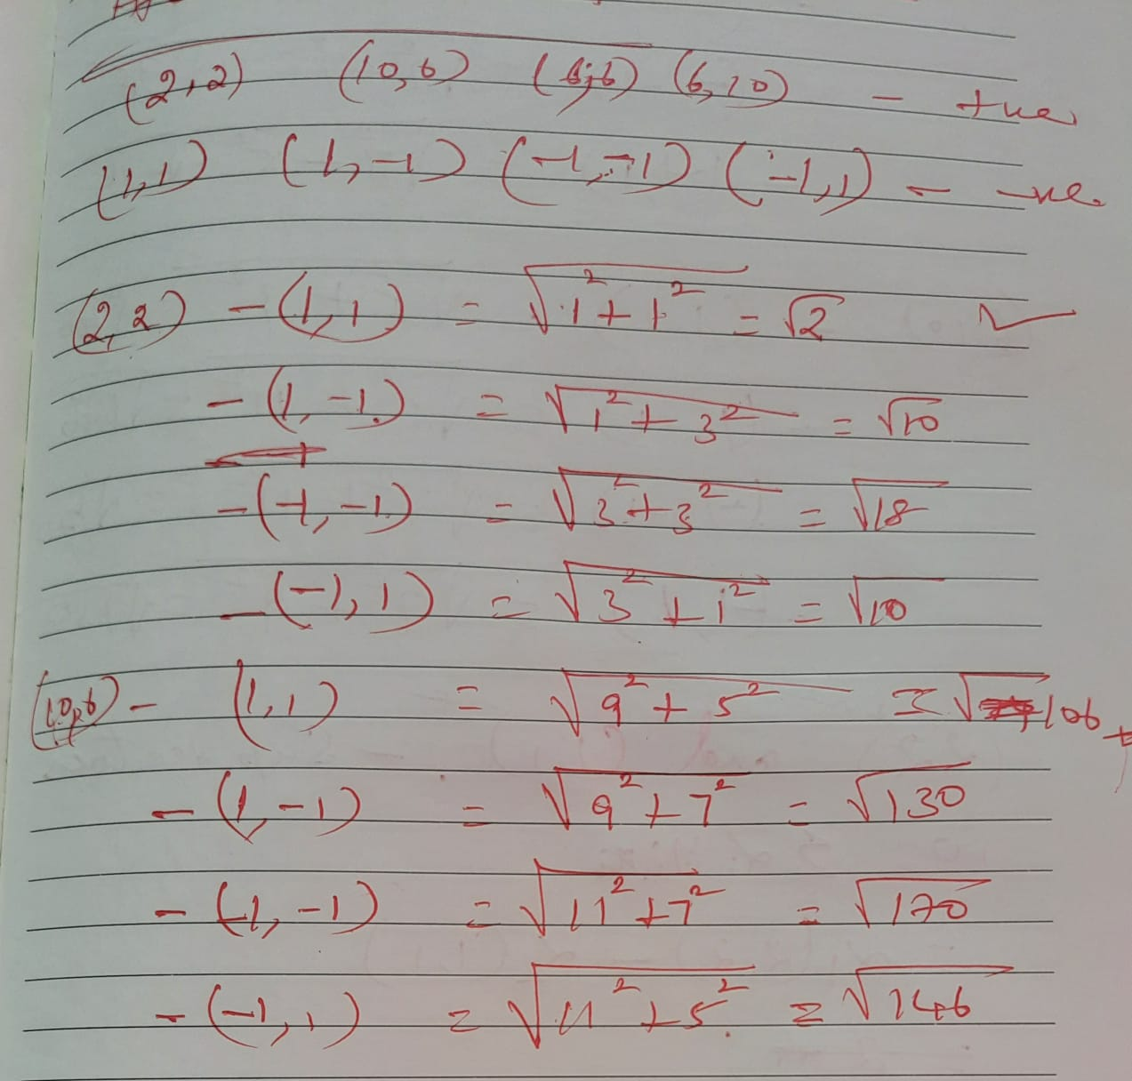

Slide 14
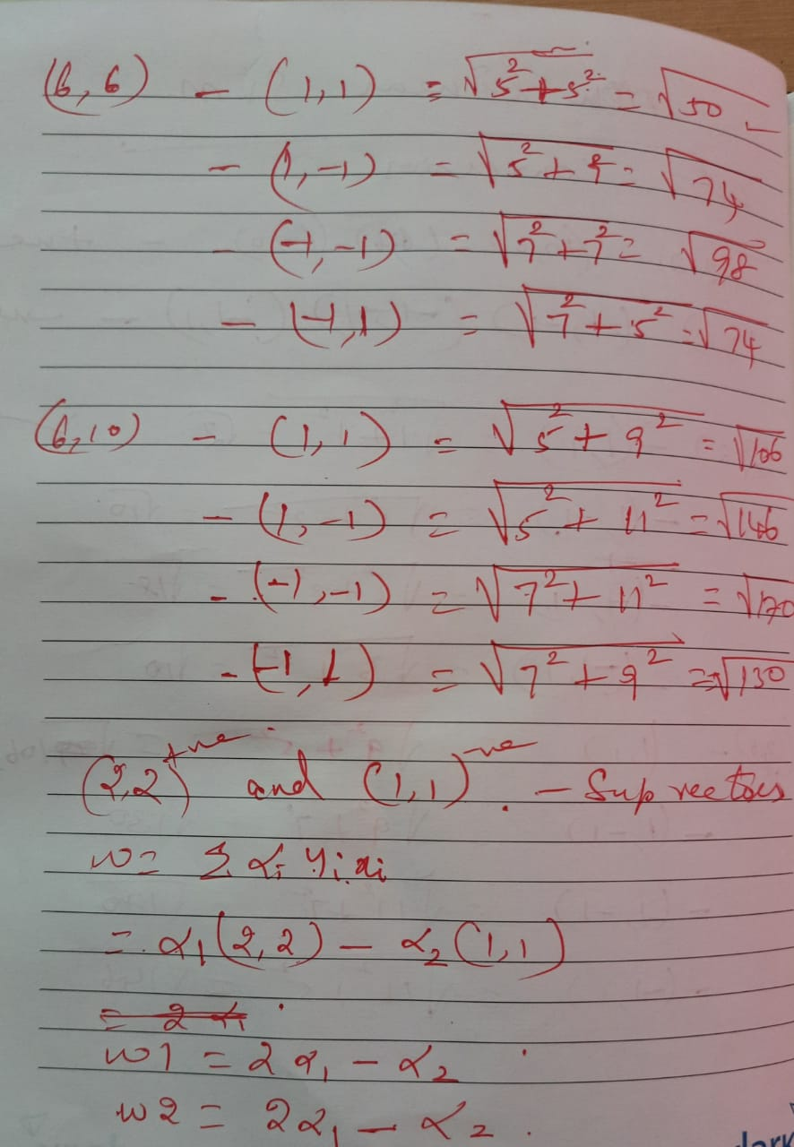

Slide 15
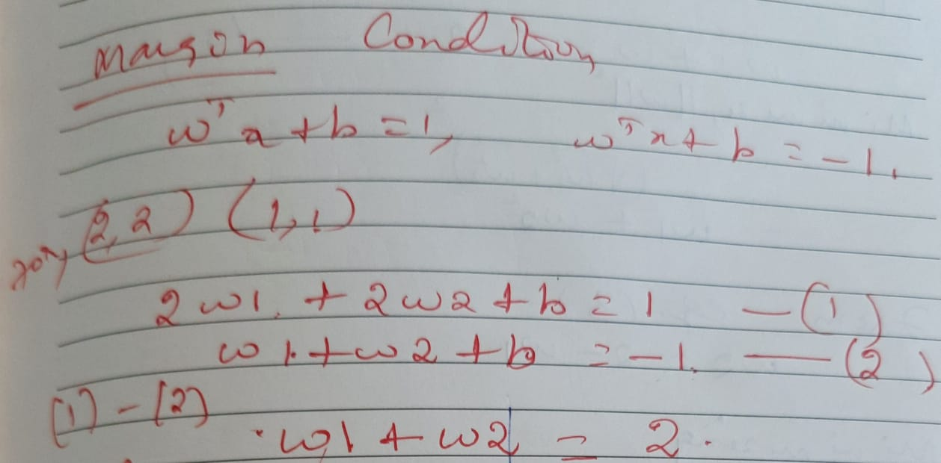

Slide 16
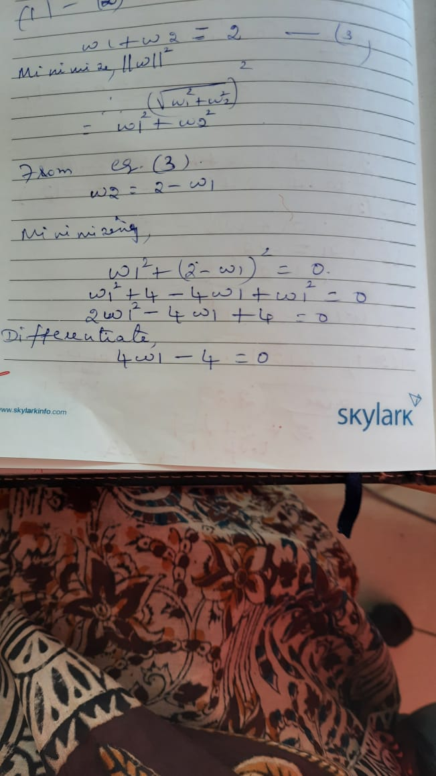

Slide 17
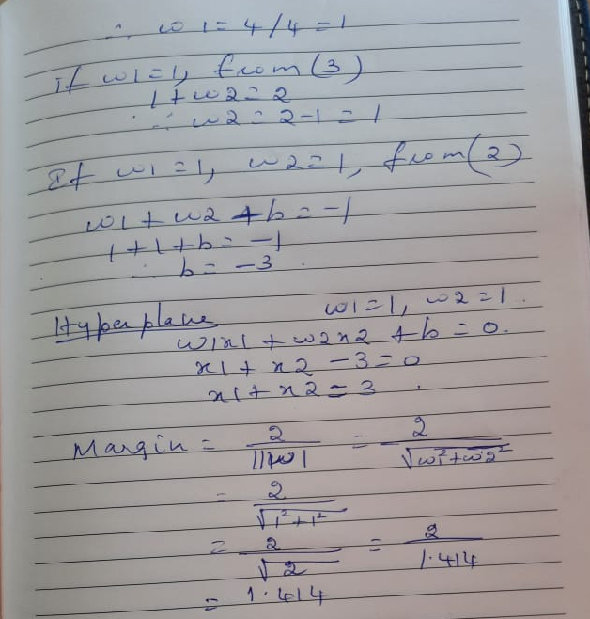

Slide 18
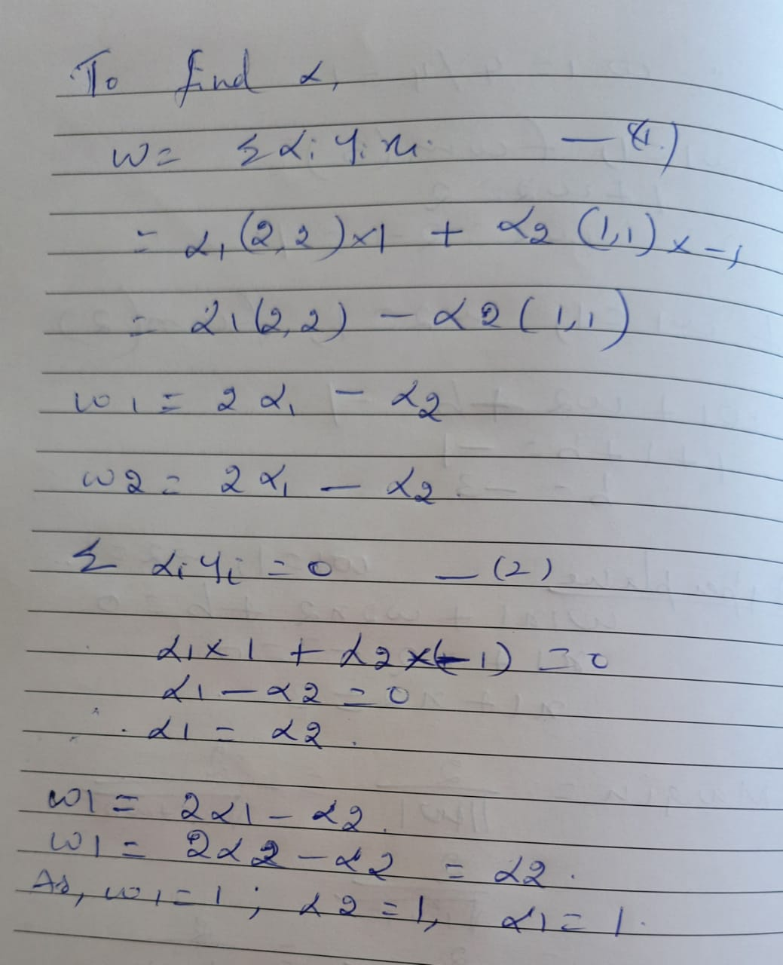

Slide 19
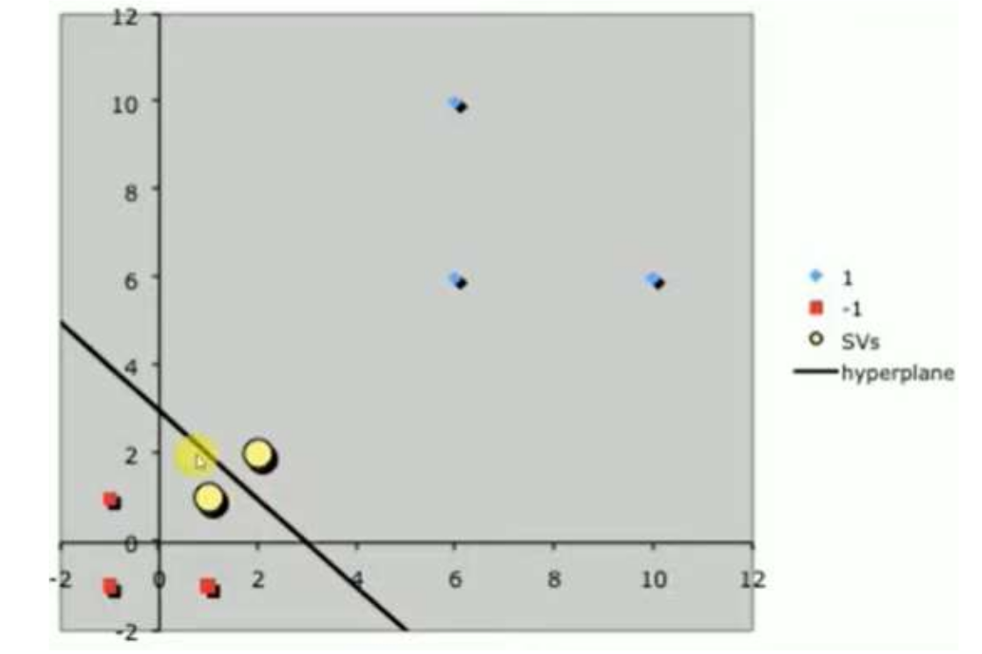

Slide 20
Find best hyperplane

Slide 21
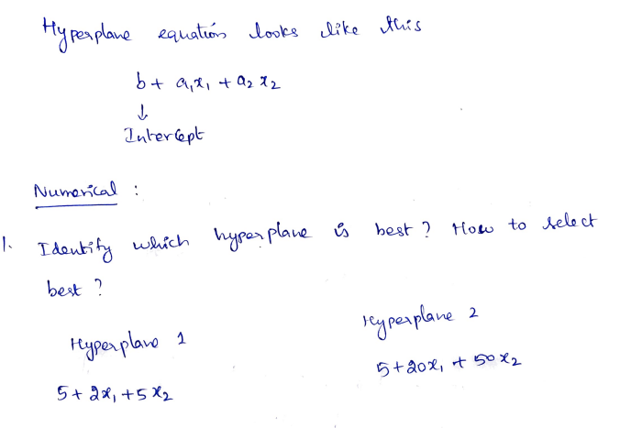

Slide 22
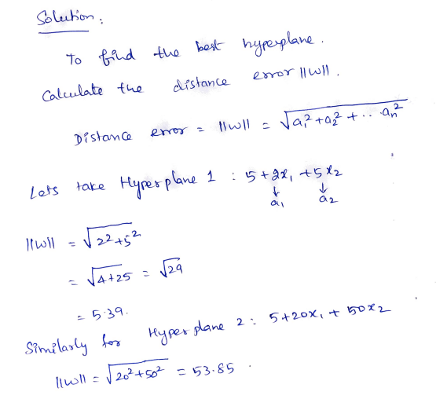

Slide 23
